Slide 1

CAMPUS LOST & FOUND PORTAL

Slide 2
ABSTRACT
The Basavatarakam Hospital Management System is a web-based application designed to simplify hospital operations such as patient registration, appointment scheduling, doctor management, and billing. This system helps hospital staff manage patient details efficiently and securely. By using technologies like HTML, CSS, and JavaScript, it provides an interactive and user-friendly interface that improves the overall efficiency of hospital administration.

Slide 3
EXISTING SYSTEM
In most campuses, lost and found processes are handled manually, using notice boards or physical registers.
Students and staff must visit the administrative office to report or check for lost items.
No centralized database exists to record or track lost and found items efficiently.
Information about lost items often spreads through word of mouth or social media, leading to confusion and misinformation.
Delay in communication between the finder and the owner results in low recovery rates.
There is no proper verification or authentication, increasing the chances of false claims.
Records, if maintained, are paper-based, which are prone to loss, damage, or duplication.
Searching for a particular item among manual entries is time-consuming.
The existing approach lacks notifications or tracking features, causing inconvenience to users.
Overall, the manual system is inefficient, unorganized, and not scalable for large campus populations.

Slide 4
PROPOSED SYSTEM
The Campus Lost and Found Portal provides a centralized digital platform to manage all lost and found activities within the campus.
Users can register, log in, and securely report lost or found items through the web application.
The system uses a database (MySQL) to store all item details, user information, and communication logs.
The backend (Spring Boot + Hibernate) ensures smooth data handling, validation, and processing.
The frontend (Thymeleaf + JavaScript + CSS) offers an interactive and user-friendly interface.
Users can upload images and descriptions to help identify items accurately.
A search and filter feature allows users to quickly find matching lost or found items.
Email notifications are automatically sent when an item potentially matches a user’s report.
Admins can verify and approve posts to maintain data accuracy and prevent misuse.
The system helps save time, improve efficiency, and ensure transparency in the item recovery process.
It enhances campus communication and security by providing a reliable, automated, and traceable solution.

Slide 5
ADVANTAGES
Provides a centralized online platform for managing lost and found items within the campus.
Saves time and effort by eliminating manual record-keeping and physical visits.
Ensures quick search and retrieval of lost items using advanced filters and categories.
Reduces misinformation through verified and moderated postings.
Offers secure user authentication to prevent unauthorized access or false claims.
Automated email notifications keep users informed about matching or recovered items.
Enhances communication between finder and owner through an integrated system.
Maintains accurate and permanent digital records, minimizing data loss.
User-friendly interface improves accessibility for students, faculty, and staff.
Scalable and flexible architecture allows easy future expansion or feature integration.
Promotes eco-friendly digital operations by reducing paper usage.

Slide 6
DISADVANTAGES
Requires a stable internet connection for users to access the portal.
Initial setup and deployment may be slightly complex for beginners.
Database maintenance and periodic backups are necessary to prevent data loss.
Server or network downtime can temporarily make the system unavailable.
Users must register and log in, which may discourage one-time or casual users.
Security threats like data breaches or unauthorized access may occur if not properly managed.
Image uploads may consume extra storage space over time.
The system’s performance may slow down if the number of records increases significantly without optimization.
Dependency on technology—manual reporting becomes difficult if the portal fails.
User training or guidance may be required for non-technical staff to operate efficiently.

Slide 7
HARDWARE REQUIREMENTS
Processor: Intel Core i3 or higher (recommended i5/i7 for better performance).
RAM: Minimum 4 GB (8 GB recommended for smooth operation).
Hard Disk: At least 250 GB storage capacity for database and project files.
Monitor: Standard 15” or larger display for clear interface visibility.
Keyboard and Mouse: For user input and navigation.
Network Interface Card (NIC): To enable LAN or Wi-Fi connectivity.
Server System (Optional): A dedicated machine for hosting the backend and database.
UPS (Uninterrupted Power Supply): To prevent data loss during power interruptions.
Camera or Mobile Device: For capturing and uploading item images.
Router / Internet Connection: To ensure stable access for users and administrators.

Slide 8
SOFTWARE REQUIREMENTS
Operating System: Windows 10 / 11, Linux (Ubuntu), or macOS.
Programming Language: Java (JDK 17 or above recommended).
Backend Framework: Spring Boot (for REST API and business logic).
Frontend Technologies: HTML, CSS, JavaScript, and Thymeleaf (for dynamic web pages).
Database: MySQL (for data storage and retrieval).
ORM Tool: Hibernate / JPA (for database mapping and CRUD operations).
Server: Apache Tomcat (embedded in Spring Boot).
IDE (Integrated Development Environment): IntelliJ IDEA / Eclipse / Spring Tool Suite (STS).
Build Tool: Maven or Gradle (for dependency management).
Version Control: Git / GitHub (for code management and collaboration).
Web Browser: Google Chrome / Mozilla Firefox / Microsoft Edge (for testing and access).
Email API / SMTP Configuration: For sending notification emails.
Postman / Swagger: For API testing and documentation.

Slide 9
MODULES
User Module:
Handles user registration, login, and profile management.
Lost & Found Module:
Allows users to post details of lost or found items with images and descriptions.
Search & Match Module:
Enables users to search items and automatically suggests possible matches.
Notification Module:
Sends email or in-app alerts for matched or verified items.
Admin Module:
Admin reviews posts, manages users, and maintains system data.
Security & Database Module:
Ensures data protection, authentication, and efficient database operations.

Slide 10
MODULE DESCRIPTION
User Module: This module manages all user-related operations, including registration, login, updates. It ensures user has secure and personalized access to post, search, items.
Lost & Found Module: Handles the submission of lost and found item reports with details. Supports photo uploads to make identification and verification of items easier.
Search & Match Module: Enables users to browse and locate items quickly using keyword or filter-based search. The system automatically matches similar entries between lost and found posts to speed up recovery.
Notification Module: Keeps users informed through real-time notifications or emails whenever a matching item is detected.
Admin Module: Provides the administrator with tools to monitor system activity, verify posts, and handle user management. Maintains data accuracy and content moderation to prevent false or duplicate entries.
Security & Database Module: Responsible for data handling, encryption, and secure storage of user and item records in MySQL. Incorporates authentication and access control mechanisms to protect sensitive information.

Slide 11
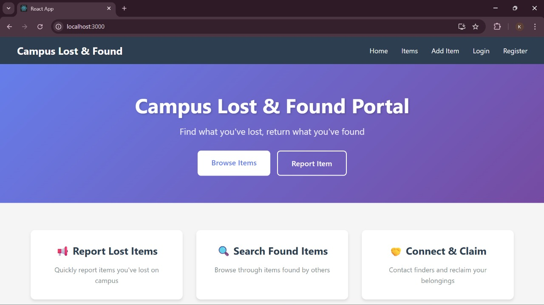
SAMPLE OUTPUT

Slide 12
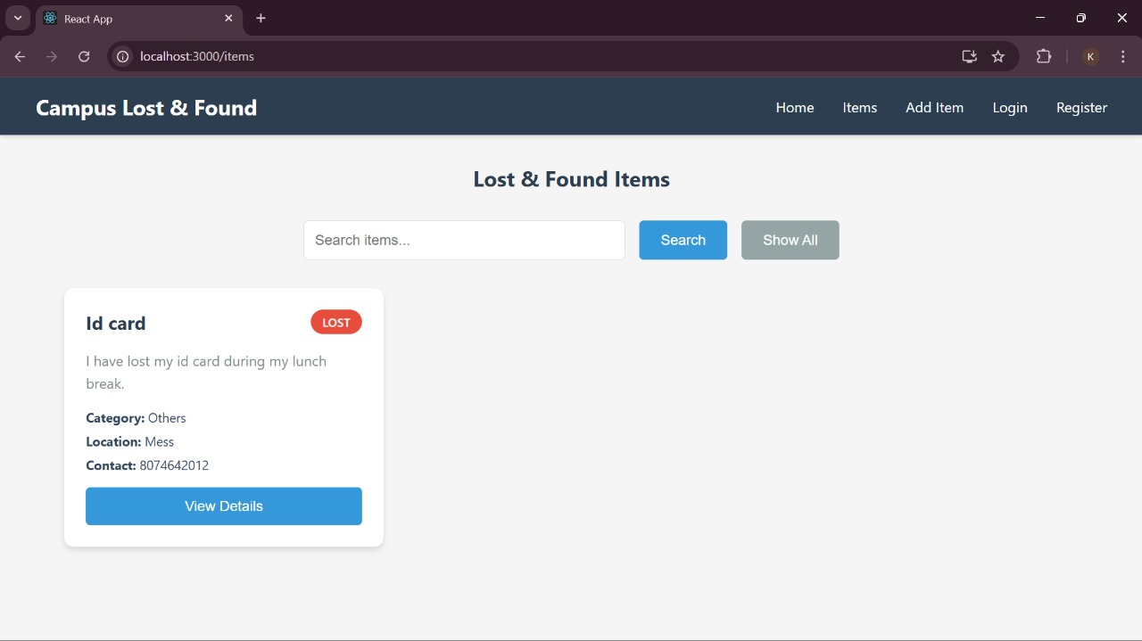
SAMPLE OUTPUT

Slide 13
CONCLUSION
The Campus Lost and Found Portal successfully provides a digital solution to manage lost and found items within the campus.
It replaces the manual, time-consuming process with an efficient and automated web-based system.
The portal enhances communication between users and improves the chances of item recovery.
Admin verification and secure login ensure reliability and prevent misuse.
The use of Java full-stack technologies (Spring Boot, Hibernate, MySQL, Thymeleaf) makes the system robust and scalable.
Email notifications and search filters add convenience and speed to the item retrieval process. The project promotes digitalization, transparency, and user trust within the campus environment.
In the future, features like mobile app integration, QR-based tracking, and AI-based image matching can further enhance system efficiency.

